Slide 1
Interpreting paintings using image semantic segmentation and decision trees
Briones, Mina

Slide 2
introduction
All about our thesis proposal.

Slide 3

Background of the study
¤
Art Interpretation
¤
Assistance
¤
Image Semantic Segmentation
¤
Decision Trees

Slide 4
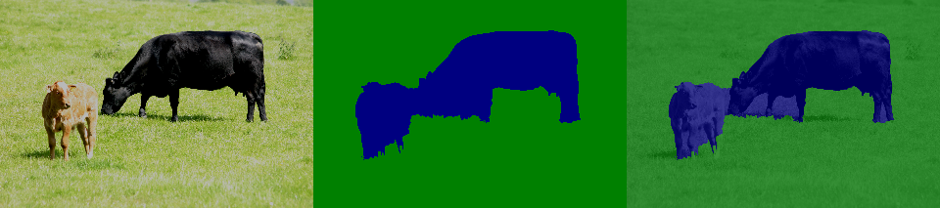
Definition of terms
¤
Semantic Segmentation
¤
Decision Trees

Slide 5
Statement of the problem
¤
What are the characteristics that makes a theme unique and similar to the other?
¤
What model is suitable for Semantic Segmentation in paintings?
¤
How will the results of the Semantic Segmentation affect the Decision Trees?
¤
How will the Decision Trees evaluate the results?

Slide 6
objectives
¤
Compare and contrast the characteristics that are unique and similar to the themes.
¤
Find out which model is suitable for Semantic Segmentation in paintings.
¤
Explain the relationship between Semantic Segmentation and Decision Trees.
¤
Explain how will the Decision Trees evaluate the results.

Slide 7
Review of related literature
A review about existing studies that are related to our proposal.

Slide 8
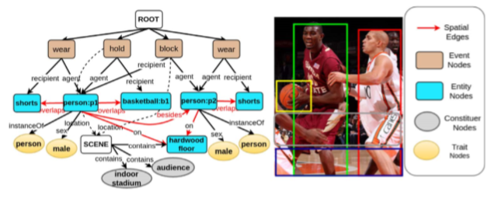
2.1 Image interpretation

Slide 9
2.2 Approaches
Convolutional Neural Network

Slide 10
2.2 Approaches
Fully Convolutional Network

Slide 11
2.2 Approaches
Dense Image Labeling
S. Zeng et al. Dense Semantic Image Segmentation with Objects and Attributes.
Goal: A more accurate result in describing the image.
Conditional Random Field (CRF) :
Multi-class CRF for Objects
Multi-label CRF for Attributes
Factorial CRF for Objects
42% average label accuracy
5%, 4.4%, 10.1%
61.4% label-accuracy overall (aNYU dataset)

Slide 12
2.2 Approaches
Dense Image Labeling
Islam et al. Dense Image Labeling using Deep Convolutional Neural Networks.
Goal: Similar objectives.
Deep Convolutional Neural Networks (DCNN):

